Slide 1
Friends don’t let friends do IaaS

Slide 2





French PowerShell Saturday
Merci à nos sponsors !!
15 Septembre 2018 - #FrPwshSat2018

Slide 3
Chris Gardner
DevOps and ALM consultant at Black Marble
3+ Years PowerShell experience
Spent the last year+ automating software builds and writing DSC
Contribute to various DSC resources and maintain 1 of my own
Usually found on Slack (PSUGUK and PowerShell)
https://www.github.com/ChrisLGardner

Slide 4
Agenda
What is DSC
How DSC works (briefly)
Why use DSC
How is it used in Azure
Demos

Slide 5
What is DSC?
Desired State Configuration.
Configuration management framework built on PowerShell
Uses resources to handle configuration of parts of the system
Configurations are PowerShell scripts
Notes:
Config Management tools like Chef or Puppet are main way to leverage this.

Slide 6

How DSC works
Configuration.ps1
Configuration.mof
Compile configuration
Apply configuration

Slide 7
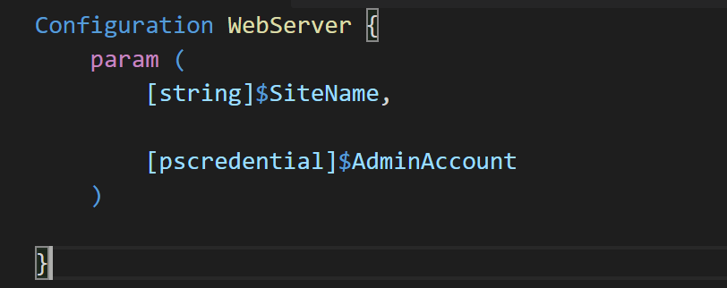
Components of a Configuration
Special keyword “Configuration” and accept parameters like a function.

Slide 8
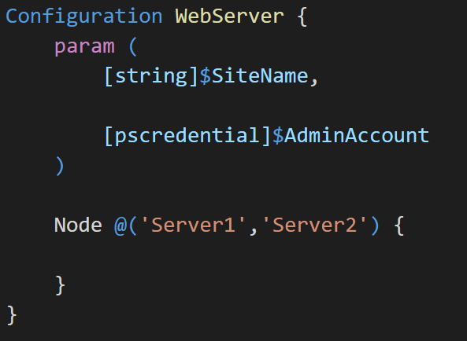
Components of a Configuration
Each configuration can target 1 or more nodes using the “Node” keyword.
Each named server will generate a mof file named for it.

Slide 9
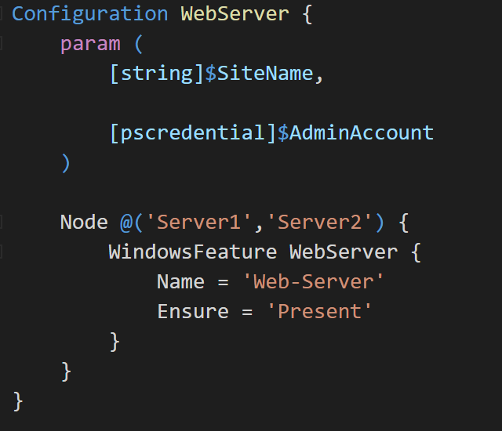
Components of a Configuration
Resources are the method used to define how a specific aspect of the computer should be configured.
Resources can configure anything as long as you can test its current state and set its state.

Slide 10
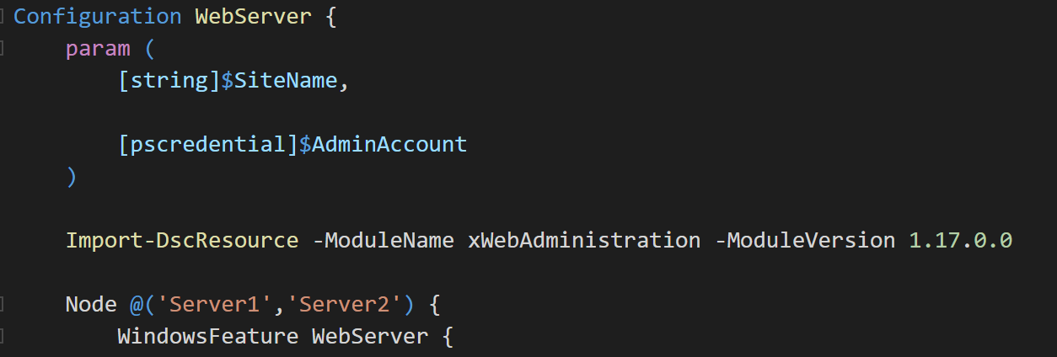
Components of a Configuration
Resources are imported using the Import-DscResource cmdlet.
All resources must be imported this way except the builtin PSDesiredStateConfiguration module.

Slide 11
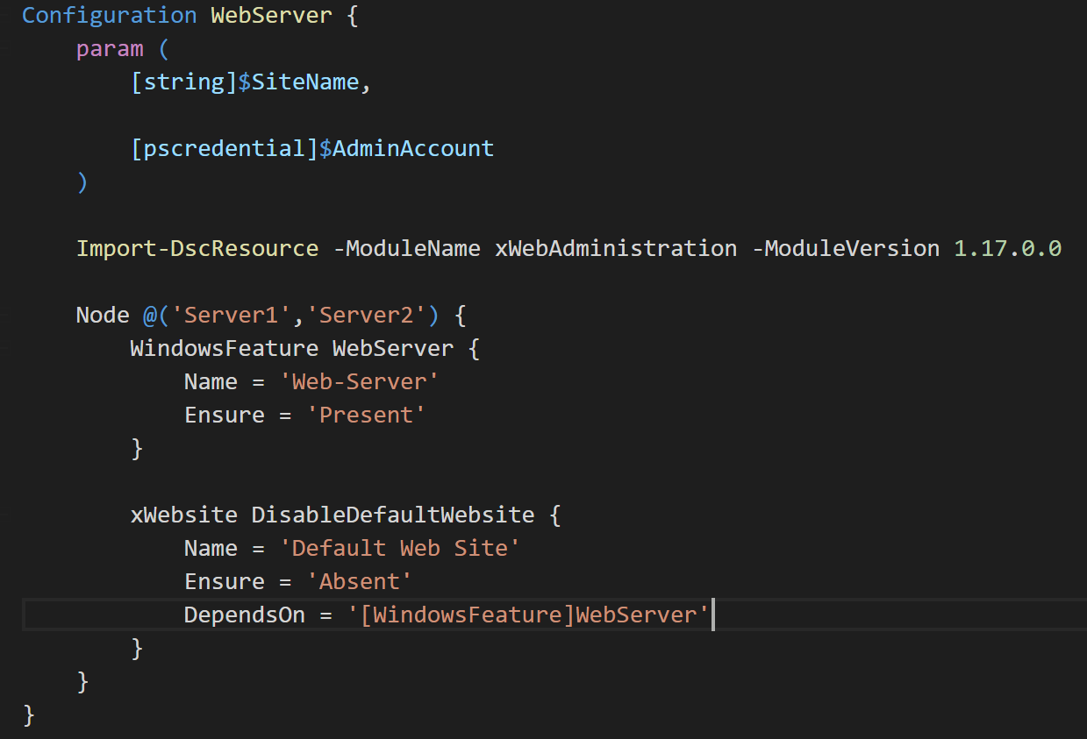
Components of a Configuration
Resources can depend on others to ensure correct order of execution.
Unlike ARM templates the sequencing is always serial.
Without any DependsOn the order of execution is the order in the configuration.

Slide 12
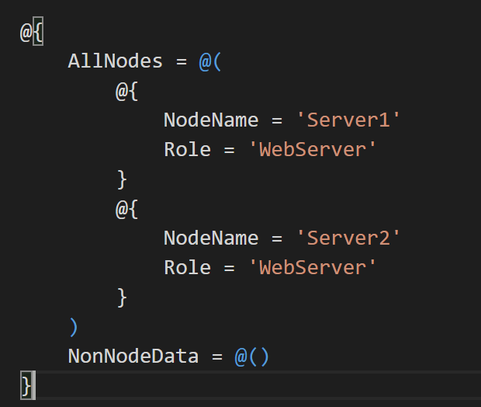
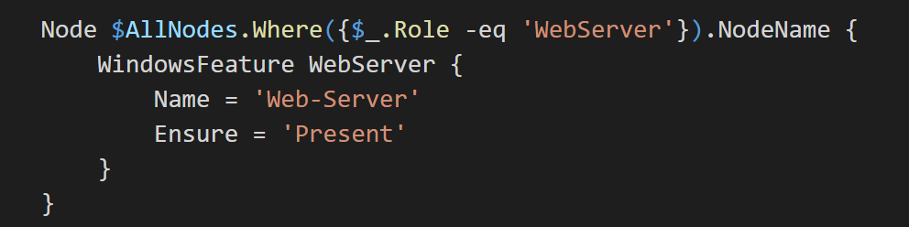
Components of a Configuration
Configuration Data is a method for separating the “What” from the “Where”.

Slide 13
Demo – Generating a MOF

Slide 14
Why use DSC?
Configurations are simple code files, so will be stored in source control
Resources are PowerShell modules, either normal or class based
Custom Resources are easy to write and publish
A lot of resources already available via PowerShellGallery.com and github
Lots of documentation and blogs available

Slide 15
How is it used in Azure?
Extension on a VM
Can be added using ARM Templates, PowerShell, Azure CLI or Portal
Push or Pull configuration
Push using zip file with configuration ps1 and resources
Pull using Azure Automation or an on-prem pull server

Slide 16
Push Configuration
Configuration files and any resources are stored in a zip
Zip stored somewhere accessible to Azure.
Useful for testing configurations or test environments
Can’t update configurations via redeploying ARM template.

Slide 17
Pull Configuration
Configuration compiled and mof stored on a Pull server
Resources stored on a Pull server
Azure Automation can be a pull server and is free for Azure VMs
Register a node with a Pull server via ARM template/PowerShell/etc
Updated configurations automatically propagate to nodes at set intervals
Reporting into OMS or other tools to see node status.

Slide 18
Demo – Azure Automation

Slide 19
Questions?

Slide 20


Chris Gardner
@halbaradkenafin
Chrislgardner.github.io
github.com/chrislgardner
Contact Details

